Slide 1
Android WebRTC + USB Video Camera
KUAN-TING LAI
https://github.com/kuanting/android_uvc_webrtc

Slide 2
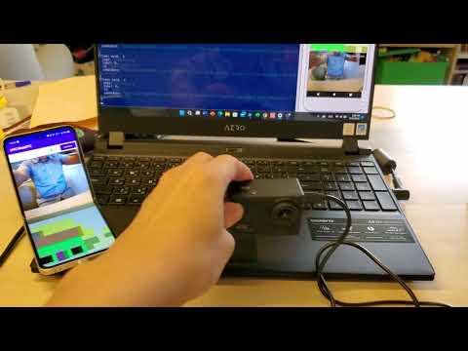

Slide 3
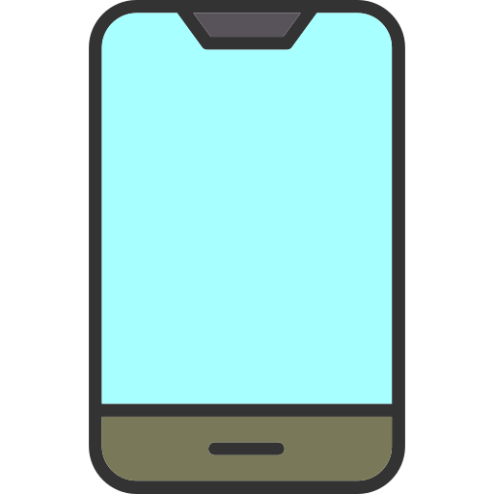
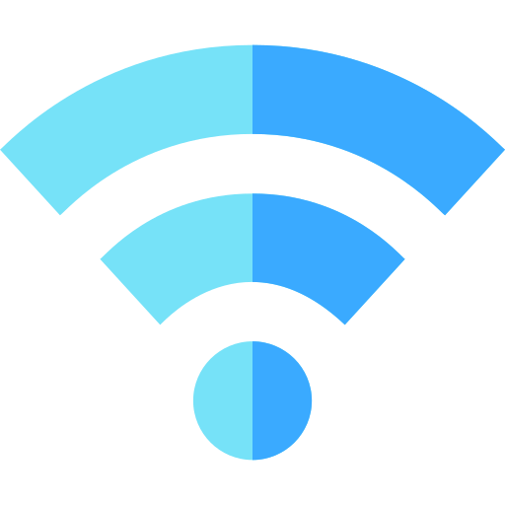


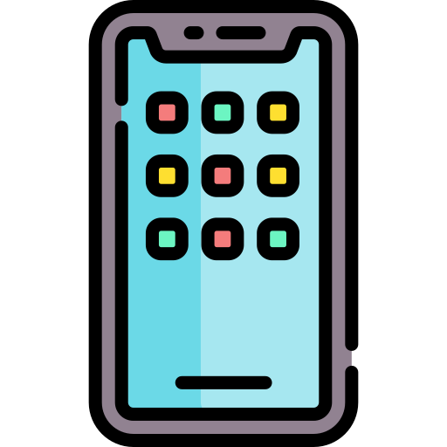



AndroidWebRTC
USB Video Camera

Slide 4
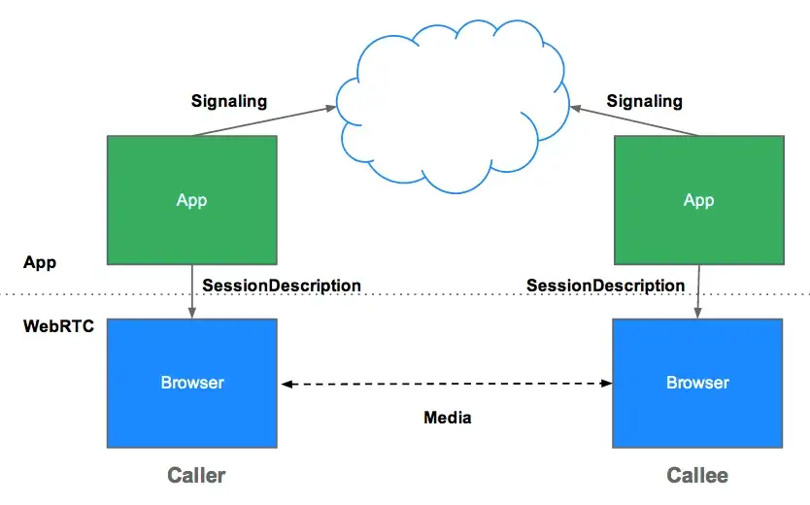
AndroidWebRTC
WebRTC uses RTCPeerConnection to communicate streaming data between browsers (aka peers) but also needs a mechanism to coordinate communication and to send control messages, a process known as signaling.

Slide 5
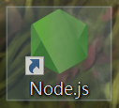

Install

Slide 6

Server Step
Cd to android_uvc_webrtc-main\signal_server folder
Run npm install
Run node signal_server.js

Slide 7
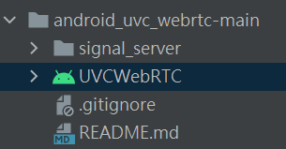
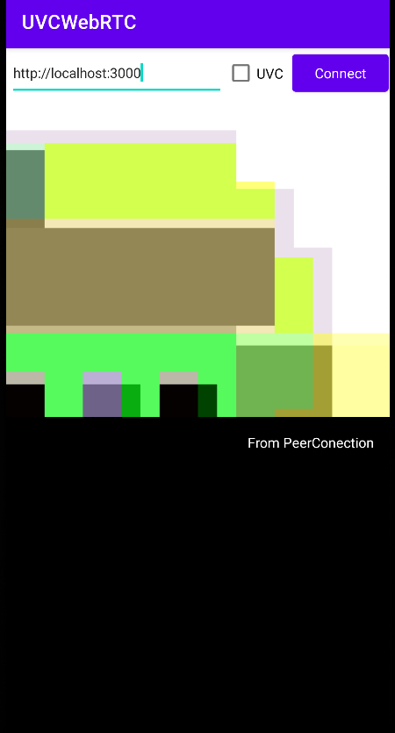


APP Step
Use Android Studio to open UVCWebRTC folder.
Install app on PC or phone.
Input http://(your server IP):3000 or http://localhost:3000
If you use USBCAM ,tick UVC
Click Connect to connect to the server

